Slide 1
Programming Merit Badge Part 1
Notes:
https://boyslife.org/merit-badges/programming-merit-badge/

Slide 2
Requirements
Safety. Do the following:
Show your counselor your current, up-to-date Cyber Chip.
Discuss first aid and prevention for the types of injuries or illnesses that could occur during programming activities, including repetitive stress injuries and eyestrain.
History. Do the following:
Give a brief history of programming, including at least three milestones related to the advancement or development of programming.
Describe the evolution of programming methods and how they have improved over time.

Slide 3
Requirements, cont’d
General knowledge. Do the following:
Create a list of 10 popular programming languages in use today and describe which industry or industries they are primarily used in and why.
Describe three different programmed devices you rely on every day.
Intellectual property. Do the following:
Explain how software patents and copyrights protect a programmer.
Describe the difference between licensing and owning software.

Slide 4
Requirements, cont’d
Intellectual property. Do the following:
Describe the differences between freeware, open source, and commercial software, and why it is important to respect the terms of use of each.
Projects. Do the following:
With your counselor’s approval, choose a sample program. Then, as a minimum, modify the code or add a function or subprogram to it. Debug and demonstrate the modified program to your counselor.

Slide 5
Requirements, cont’d
Projects. Do the following:
With your counselor’s approval, choose a second programming language and development environment, different from those used for requirement5a and in a different industry from 5a. Then write, debug, and demonstrate a functioning program to your counselor, using that language and environment.
With your counselor’s approval, choose a third programming language and development environment, different from those used for requirements 5a and 5b and in a different industry from 5a or 5b. Then write, debug, and demonstrate a functioning program to your counselor, using that language and environment.

Slide 6
Requirements, cont’d
Projects. Do the following:
Explain how the programs you wrote for requirements 5a, 5b, and 5cprocess inputs, how they make decisions based on those inputs, and how they provide outputs based on the decision making.
Careers. Find out about three career opportunities in programming. Pick one and find out the education, training, and experience required. Discuss this with your counselor and explain why this career might be of interest to you.

Slide 7
What is Programming?
Notes:
Before we get started --- What is programming?
Programming is the act of inserting instructions into a computer or machine to be followed.
There are many different career fields involving the programming of computers; each utilizing different languages, techniques, and systems.
We are only going to cover a few of the different aspects of programming during this Merit Badge, but there are so many more.

Slide 8
Requirement 1b - Safety

Slide 9
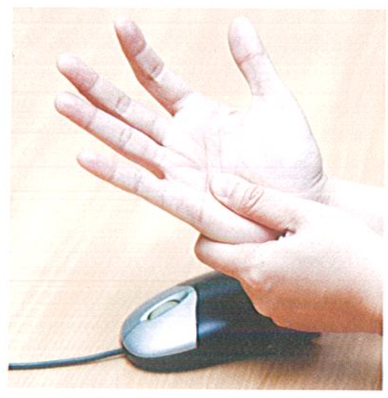
Repetitive Stress Injuries (RSIs)
Carpal tunnel syndrome
Cervical radiculopathy
Epicondylitis
Reflex sympathetic dystrophy
Tendonitis
Notes:
Carpal tunnel syndrome—swelling inside a narrow “tunnel” formed by bone and ligament in the wrist that can lead to pain, tingling, and numbness; the tunnel surrounds nerves that conduct sensory and motor impulses to and from the hand
Cervical radiculopathy—disk compression in the neck, often caused by repetitive cradling of a phone on the shoulder
Epicondylitis—elbow soreness often called “tennis elbow”
Reflex sympathetic dystrophy—a painful condition marked by dry, swollen hands and loss of muscle control
Tendonitis—tearing and inflammation of tendons connecting bones to muscles
Besides developing RSIs, programmers can become dehydrated, experience back problems, and develop eyestrain and headaches.

Slide 10
Repetitive Stress Injuries (RSIs)
First Aid for RSIs
Apply an ice pack to the injured area to help reduce pain and swelling.
Use an elastic joint support or wrap the area firmly with an elastic bandage to limit the swelling and to protect the injury. Do not wrap so tightly that blood circulation is restricted.
Rest the injured area.
Take an anti-inflammatory pain reliever as recommended by your physician.
After 24 hours, heat (hot packs, heating pad, whirlpool) may be applied.
As symptoms diminish, gently exercise the affected muscles or joints to help relieve remaining symptoms
Notes:
If pain is severe or persistent, seek medical attention.

Slide 11
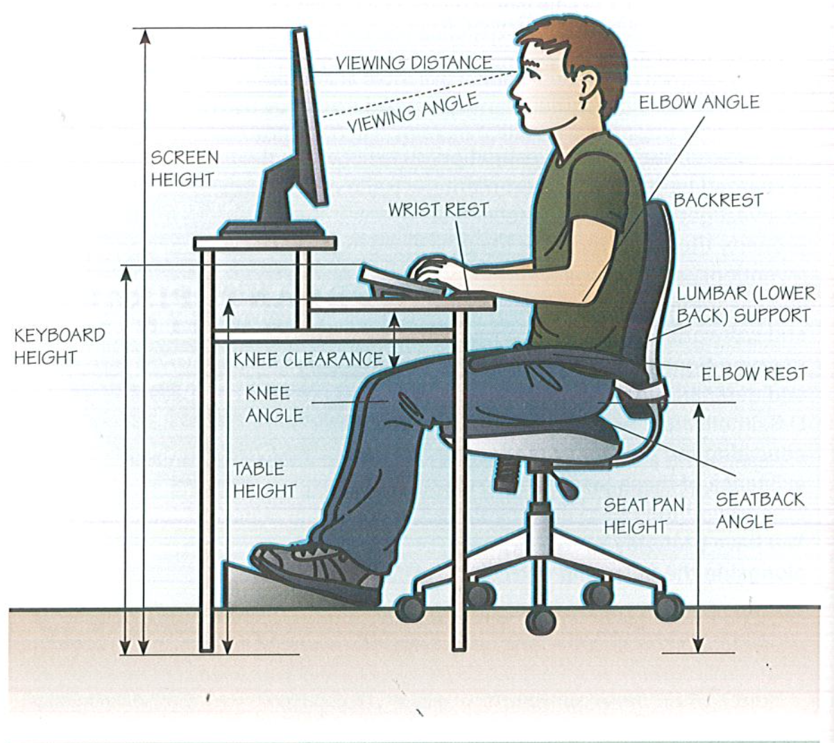
Proper Ergonomic Setup
Notes:
Proper equipment and preparation are the keys to prevention. Make sure your equipment is set up properly to prevent injuries (see the ergonomics diagram).
Also be aware that hydration isn’t solely for hiking or playing sports—programmers need to stay hydrated too. Four 8-ounce glasses of water per day is a good number. Soda, juices, and other sweet drinks are not a substitute for water.
To help prevent eyestrain, program in a well-lit room. Minimize the contrast between your monitor and the rest of the room but make sure there is no glare on the screen.
Proper posture is the key to avoiding back pain and injuries (see the information on ergonomics). And just as when you participate in athletic activities, taking breaks to give your body time to recover and prevent strain is essential.

Slide 12
Take a Break
Eye breaks.
Typing breaks.
Rest breaks.
Exercise break.
Notes:
Eye breaks. Look away from the monitor from time to time, preferably at something more than 20 feet away. This gives your eyes a chance to relax and helps prevent eye strain
Typing breaks. Most typing is done in bursts. Rest your hands in a relaxed, flat, straight manner to give them time to recover and prevent RSIs
Rest breaks. Take a break every 30 minutes or so to give your body a chance to relax. You can use software programs to remind you to take breaks, so you don’t get stuck in a trace staring at your monitor.
Exercise breaks. Get up and stretch, rotate your head and shoulders, move your arms and legs. You will find you can program better and longer if you do this regularly.

Slide 13
Requirement 2a – History of Programming

Slide 14
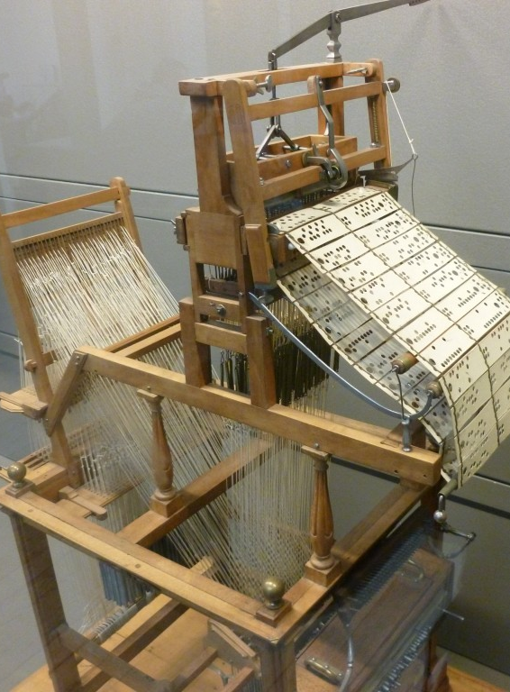
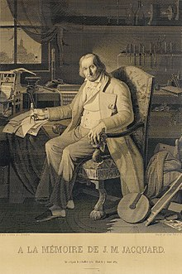
Machine Programming
Notes:
Before the modern electrical computer, mechanical devices used in factories were the first machines to be programmed.
An example is the Joseph Jacquard Loom (1804) which used hole-punched cards to “program” patterns into fabric.
The picture on the left is the loom.
The picture on the right is a portrait of Jacquard was woven in silk on a Jacquard loom and required 24,000 punched cards to create (1839). One of these portraits in the possession of Charles Babbage inspired him in using perforated cards in his Difference Engine.

Slide 15
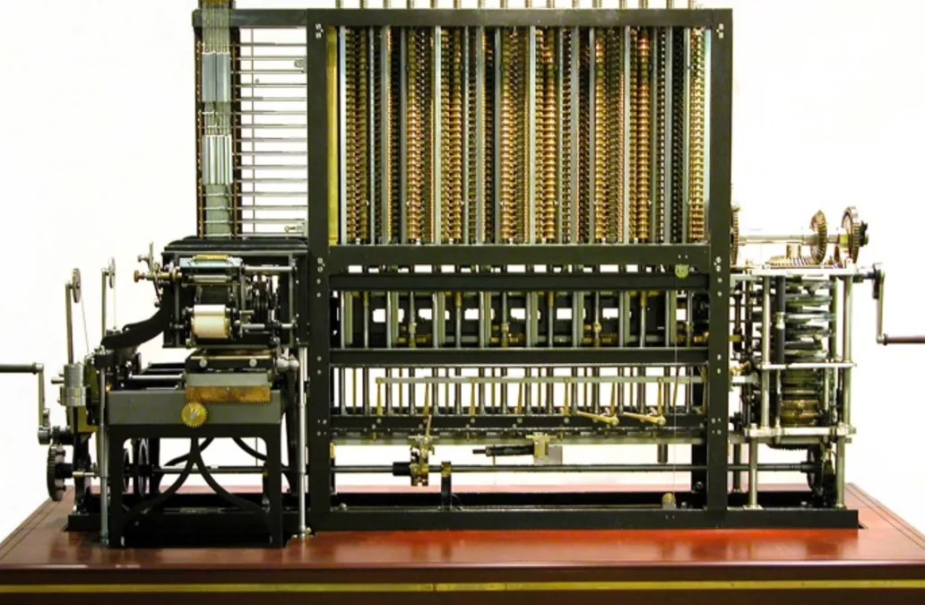
Difference Engine
Notes:
Charles Babbage in 1823 started work on his Difference Engine.
It was programmed using punch cards and could do simple calculations to 31 digits.
Due to high costs, it was not built until 1991, well after his death.
It weighed 15 tons and was 8 ft tall.
It used human-power to turn the gears and cranks and output the result using wheels with digits painted on.
Fun Fact: The gear technology didn’t exist to build his machine, so Babbage invented new ways of cutting gears. This incidentally advanced machinery and factories during the end industrial revolution (1760-1840).

Slide 16
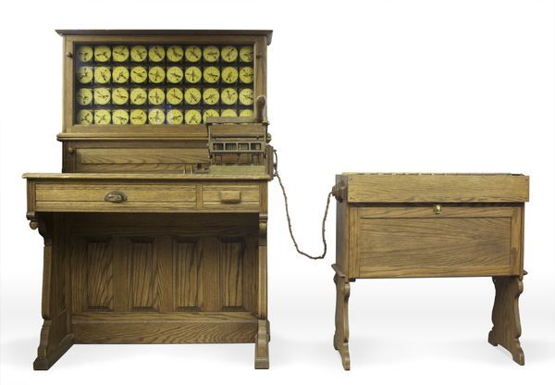
Electric Tabulating System
Notes:
In 1885, Herman Hollerith designed the “Electric Tabulating System”, a machine designed to take on the 1890’s Census.
It was an early Scantron-like machine using punch cards.
The 1880’s Census took 7 years to count, so due to the growing population, the 1890’s and 1900’s Censuses would have taken more than 10 years. This would not be good.
With his machine, the 1890’s Census only took 6 weeks rather than 10 years.
This proved computers were a viable solution to many previously impossible problems.

Slide 17
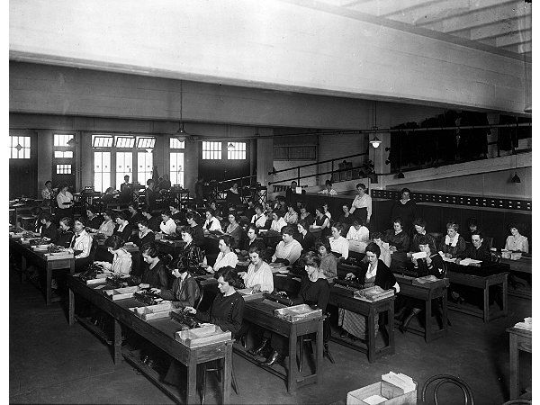
First “Computers”
Notes:
A “Computer” used to be a job description, not an electronic machine
Women almost exclusively filled these positions.
Large agencies would have “Computer Rooms” with many ladies doing calculations by hand
Has anyone seen the movie Hidden Figures?
A “kilogirl” was a unit of measurement equaling 1000 hours of computing labor

Slide 18
Katherine Johnson
Notes:
Katherine Johnson - NASA Computer
Born: Aug. 26, 1918 Died: Feb. 24, 2020 Hometown: White Sulphur Springs, WV (near Goshen) Education: B.S., Mathematics and French, West Virginia State College, 1937 Hired by NASA: June 1953 (Langley, VA) Retired from NASA: 1986

Slide 19
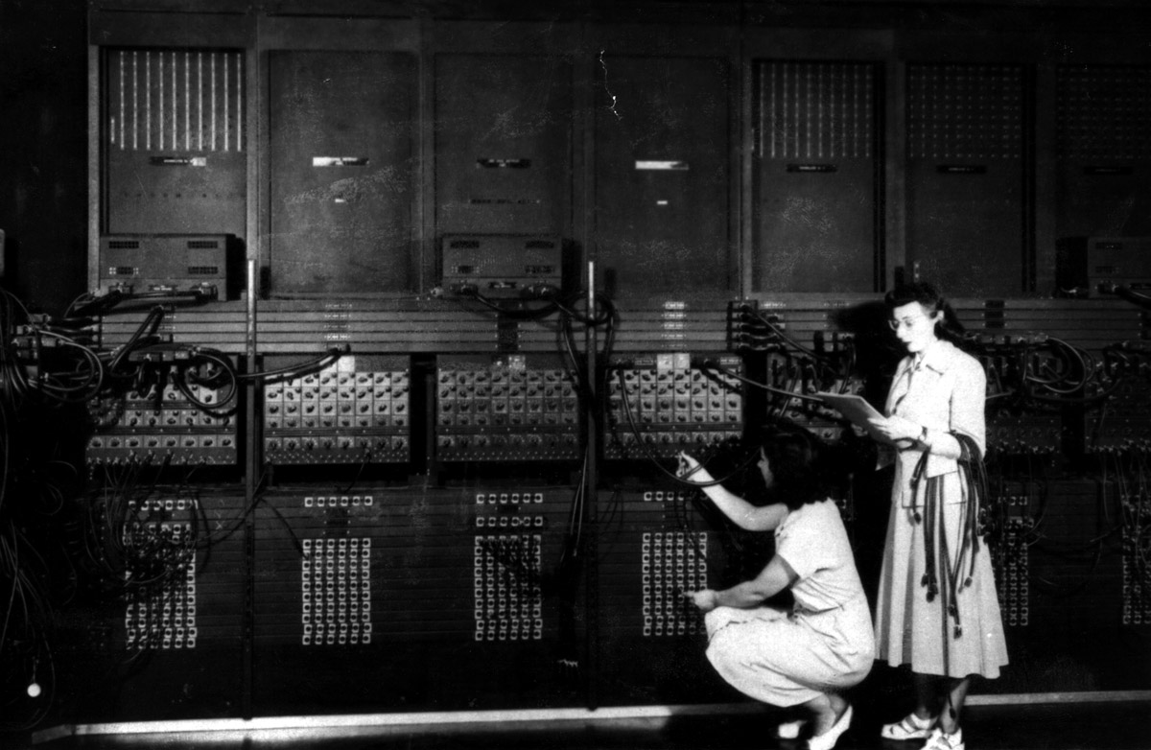
Early Computers - ENIAC
Notes:
ENIAC – Electronic Numerical Integrator And Computer (1946)
First general-purpose computer
Used Base-10 instead of Binary (Base-2)
Used Vacuum Tubes and Mechanical Switches
Used to calculate firing-tables for the military.
UNIVAC – UNIVersal Automatic Computer (1951)
First commercial computer
Brought computers into the public eye after it correctly predicted the “total-upset, landslide”, 1952 Presidential Election.
Women, not men, were the ones running these early computers.
This led to many women leading computer science into the 21st century, i.e. Grace Hopper, who programed the ENIAC. She also designed COBOL. This language is still used today.

Slide 20
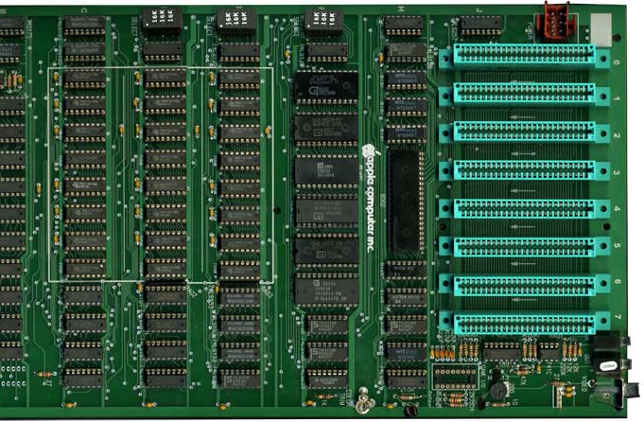
Pre-modern Computers
Notes:
After Vacuum Tube and Mechanical Switched computers, Integrated Circuits (ICs) allowed computers to get much smaller.
Computers when from the Size of buildings to the size of desks.
This also allowed more powerful computers to be built because less space was needed.
This is an Apple2 motherboard.
All the black chips make the CPU.
Each one is about 1” wide.

Slide 21
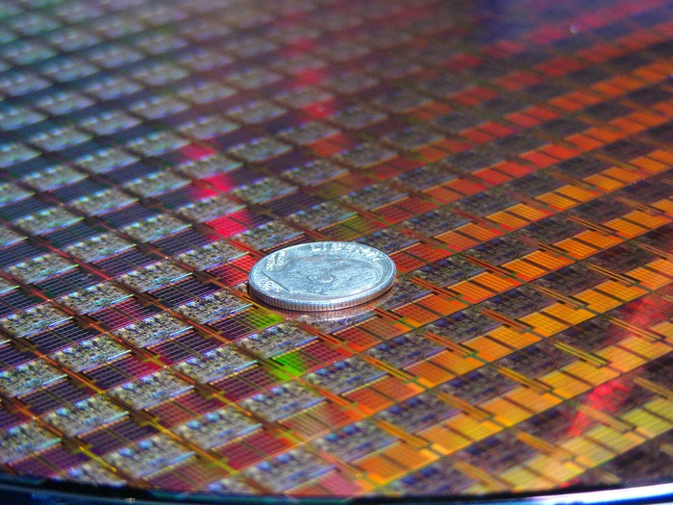
Modern Computers
Notes:
The Microprocessor allowed computers to go from the size of desks to the size of a dime!
Each small square in this picture is a computer!
This allowed use to make computers even more powerful and allow us to use even more powerful language features.
Each “switch” in these chips are 10nm wide

Slide 22
Requirement 2b – Evolution of Programming Languages

Slide 23
What is a Program?
Binary Code
There are only 10 kinds of people in the world: those who understand binary and those who don’t.
Native language of computers.
Computers only speak in 1s and 0s.
Notes:
A program is a set of instructions that tells a processor how to do a particular task. A programmer writes the instructions.
A programing language is the tool that converts the programmer’s instructions into a form the processor can understand.
Before the development of modern programming languages, developers used binary code
These two numerals used in binary language were numeric codes for the operations a computer could execute (carry out) directly.
Binary code allowed programmers to turn pieces of computer hardware (circuits) “on” (represented with a 1) or “off” (represented with a 0).
All modern programming languages are built off the concept of trying to turn human commands into binary or machine code.
Have you ever noticed that your computer’s on/off switch looks like a zero and one?

Slide 24
Binary Code
Hidden Message
Notes:
Binary is used to represent numbers, letters, symbols and images
Do you see what is meant on the previous slide by 10 types of people?
There is a hidden message in the merit badge patch in the lighter green binary code. Do you see what it is?
Hint, the last line is the letter A
What might that make the first line?
Answer: “BSA”
How many bits (1s and 0s) are in each letter?
Answer 8 – 8 bits == 1 byte

Slide 25
Assembly Language
Machine language consists entirely of numbers and is difficult for humans to read and write.
Assembly language lets a programmer use “names” or characters instead of numbers.
This slightly more human-friendly code allowed programmers to more easily program single commands for a processor.
Notes:
Each command in assembly language is specific to the processor (that is, each type of processor uses its own kind of code), so assembly language lacks the portability of most modern programming languages.
However, assembly language is ultimately how a processor executes all higher-level languages.
A high-level language is an advanced programming language that is easier for humans to understand than binary code or assembly language and is not limited to a single processor.

Slide 26
Important Early Languages
FORTRAN (Formula Translation)
Scientific and engineering programming
COBOL (Common Business-Oriented Language)
Business data processing
Pascal
Structured programming
Notes:
Today, Fortran is the primary language for some of the most demanding supercomputing tasks, such as weather and climate modeling.
COBOL was designed for banks, utility companies, government agencies, and manufacturers
Pascal is named after Blaise Pascal – mathematician. Structured programming was designed to help programmers write programs that are cleaner and easier to test, debug (remove errors), and modify.

Slide 27
Object-Oriented Programming
Saves time by reusing objects
Some OOP Languages
C++
C#
Eiffel
Java
Python
Ruby
Scala
Notes:
Object-oriented programming (OOP) is a style of programming that treats concepts as “objects” that can interact with one another.
OOP languages surfaced in the mid-1960s
The programming is done by putting together groups, or modules, of commonly used commands— instructions on how to print, how to save information to a disk, and so on — into complete programs
Have you heard of these programming languages? Have you programmed in these

Slide 28
Programming for the World Wide Web
HTTP – Hypertext Transfer Protocol
HTML – Hypertext Markup Language
JavaScript
PHP – Personal Home Page/Hypertext Preprocessor
Notes:
The Web itself is a set of files located on Internet servers (computers) and accessed using “rules” known as the hypertext transfer protocol (HTTP).
HTML is a basic language for building Webpages. Considered the first language specifically created for the World Wide Web, its purpose was to create a structure for information being presented on the Web.
JavaScript was created to enhance Web pages in a way that HTML could not. JavaScript allowed Web pages to be interactive.
PHP is a general-purpose programming language designed to produce dynamic Web pages. A dynamic page changes with each user, displaying different content each time the page is viewed.

Slide 29
Requirement 3a – Modern Programming Languages

Slide 30
Why are the languages grouped into colors?
C
C++
Java
JavaScript
HTML
CSS
Python
Ruby
PHP
OpenCL
SQL
MATLAB
Erlang
Ada
Objective-C
Swift
Mathematica
C#
Visual Basic
Rust
F#
R
Go
PowerShell
BASH
TypeScript
PostScript
CoffeeScript
Perl
x86-Assembly MASM
RegEx
PL/SQL
MIPS
ColdFusion
LaTeX
XML
JSON
Ladder Logic
YAML
Batch
Notes:
The Blue Languages are General Programing Languages
The Green Languages are Scripting Languages
The Purple Languages are Markup Languages
The Red Languages are Declarative Languages
The Orange Languages are Assembly Languages
Different types of languages have different purposes.
It is important to match the type of work to the correct language to insure the best results.

Slide 31
Purpose Behind the Languages
C++ – General Purpose, High Performance | ex. Game Engines, Desktop Apps (Adobe Photoshop, Chrome)
C – General Purpose, High Performance, Light Weight | ex. Linux OS, macOS, Integrated Circuits, Drivers
Java – General Purpose, Multiplatform | ex. Minecraft, Server Apps, Android Apps
C# – General Purpose, Windows Platform | ex. Unity Games, Server Apps, StackOverflow

Slide 32
Purpose Behind the Languages
Swift – General Purpose, iOS & macOS | ex. most apps for iPhones and macOS (replaced Objective-C)
SQL – Database Communication
JavaScript – General Web Scripting | ex. Interactive webpages, webpages that can run dynamic code
HTML – Webpage Design, Layout and Markup
CSS – Webpage Styling, Coloring, Fonts and Positioning
XML – Human and Machine-readable file format for data sharing between apps

Slide 33
Programming Examples – Hello World
C++
#include <iostream> int main(int argc, char *argv[])
{
char myString[] = “Hello World!”;
std::cout << myString << std::endl;
return 0;
}
Java
class HelloWorld {
private String myString = "Hello World!";
public static void main(String args[]) {
System.out.println(myString);
}
}
Notes:
The reason for the different colors here is due to syntax highlighting.
Syntax Highlighting is a feature in programming apps where it automatically colors different parts of the code to increase readability.

Slide 34
Programming Examples – Hello World
C#
using System;
using System.Collections.Generic;
using System.Text;
namespace ConsoleApplication1
{
class HelloWorld
{
String myString = "Hello, world!";
static void Main(string[] args)
{
Console.WriteLine(myString);
}
}
}
X86 Assembly
.486
.model flat, stdcall
.stack 100h
option casemap :none
ExitProcess PROTO Near32 stdcall, dwExitCode:dword
putch PROTO Near32 stdcall, bChar:byte; .data
strMyString byte "Hello World",0
.code
main PROC
mov ecx, LENGTHOF strMyString
mov esi, OFFSET strMyString
L1:
invoke putch, byte PTR esi
inc esi
loop L1
invoke ExitProcess,0
main ENDP
END main

Slide 35
Programming Examples – Hello World
JavaScript
myString = "Hello World!";
console.log(myString);
Python
myString = 'Hello World!'
print(myString)

Slide 36
Programming Language Types
Languages can be split into a three different levels..
High-Level (ex. Python, Ruby, JavaScript, Java, SQL)
C-Level (ex. C, C++, Rust)
Low-Level (x86 Assembly, Machine Language)
Notes:
High-Level
Pros: Easier to read, write, debug, and maintain, Multi-Platform, Compiled or Interpreted
Cons: Slower than Low-Level, not as much control over hardware
Examples: Python, Ladder-Logic, JavaScript, Java, SQL
C-Level
Best of both worlds, Compiled
Good control over hardware with ease of writing.
Examples: C, C++, Rust, FORTRAN, PASCAL
Low Level
Pros: Fast Execution, No Overhead, Single Platform, Compiled
Cons: Hard to read, write, debug, and maintain
Examples: ML, MASM, TASM, NASM, MIPS

Slide 37
Requirement 3b – Programmed Devices

Slide 38
Programmed Devices
Name 3
Examples of what they are programmed to do
Guess what languages used

Slide 39
Requirement 4 – Intellectual Property

Slide 40
Types of Intellectual Property
Copyright
Patent
Trademark
Trade Secret
Notes:
Copyright – protects a particular expression of an idea that the author created (i.e. PowerPoints, Game Art, Specific Code)
Copyright does not apply to ideas, only the expression of ideas.
Algorithms are considered ideas and are not copyrightable.
The expression of an algorithm as source or object code is copyrightable, but the algorithm can be reproduced without infringing copyright.
It is not clear what constitutes infringement of copyright with software by determining if the source code has been copied and modified or created anew.
The burden of proof is on the copyright holder to show a striking resemblance between the copyrighted and infringing code that could only result from copying.
Patent – protects useful innovative processes or methods, machines, manufactured items, or “compositions of matter”
You cannot patent abstract ideas, mathematical formulae, scientific principles, laws of nature, and mental processes.
Beyond being in scope of what is patentable, a program it must have utility, be novel, and be non-obvious.
Trademark – protects a word, phrase, symbol or sound that identifies and distinguishes the source of a particular product or service (i.e. Windows Logo, “Your mattress is freeee”, etc.)
Programmers often use trademarks to keep others from using a similar name for a competing product.
Trade Secret – protects valuable information by not disclosing it to anyone, enforced by a contract called a NDA (i.e. what info Facebook collects)
Requires the work is novel, required an economic investment to the claimant, took effort to develop, and the claimant made an effort to keep the information secret.
Trade secrecy laws are different between jurisdictions so companies operating in many different jurisdictions are taking risk that their trade secrets may not be adequately protected.
Employees and contractors that help to develop software can take knowledge learned (but not the specific code) to jobs with competitors.

Slide 41
Software Distribution
Owning means you can do what ever you want to the software. Most people do not own software.
Licensing is where you “buy or get permission” to use the software, often subscription based.
Freeware
Shareware
Demo
Open source
Notes:
Freeware. Obtaining freeware costs nothing.
“Free,” however, does not necessarily mean unlimited.
For example, the license could restrict use to particular users (e.g., personal, noncommercial users), or the license could limit the ability of an individual user to redistribute the software.
Shareware. A software developer may release a program as shareware and expect people who use the program to make a donation or pay a fee.
The developer is relying on your honor to help cover the costs of developing the software
Demo. Demo or trial software will work for a limited time or with limited features.
After the purchaser pays a license fee, the programmer provides a code that removes the limitations.
Open Source. An open-source license is a form of freeware.
This particular type of license covers the executable program and the source code developed by the programmer.
This license may come with limitations or restrictions.

Slide 42
Requirement 6 – Careers in Programming

Slide 43
Careers in Programming
Computer Scientist
Data Scientist
Mobile App Developer
Desktop App Dev
UI / UX Engineer
Software Engineer
Game Engine Dev
Gameplay Dev
Database Engineer
Hardware Engineer
Computer Engineer
Sysadmin
Hacker / Pen-Tester
Web Dev (frontend and backend)
Notes:
Any interest in one of these roles?
Education, training, experience required?

Slide 44
Next Session
Requirement 5 – Projects
Any issues installing MS Visual Studio Code and extensions?
Will review three programming languages and modify them
Python
Java
R

